Slide 1
Object Recognition

Slide 2
Object recognition
Object recognition is a general term to describe a collection of related computer vision tasks that involve identifying objects in digital photographs.

Slide 3
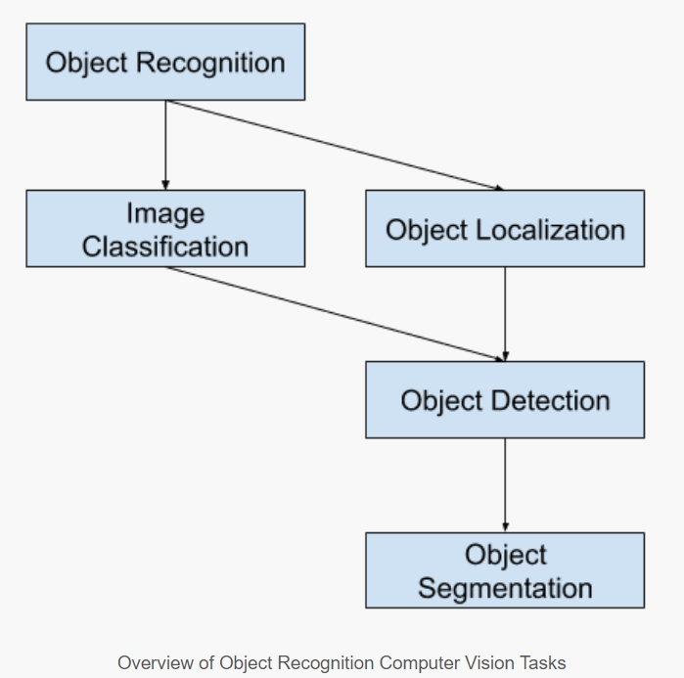

Slide 4
Image classification involves predicting the class of one object in an image.
Object localization refers to identifying the location of one or more objects in an image and drawing abounding box around their extent.
Object detection combines these two tasks and localizes and classifies one or more objects in an image.
When a user or practitioner refers to “object recognition“, they often mean “object detection“.

Slide 5
Image Classification: Predict the type or class of an object in an image.
Input: An image with a single object, such as a photograph.
Output: A class label (e.g. one or more integers that are mapped to class labels).
Object Localization: Locate the presence of objects in an image and indicate their location with a bounding box.
Input: An image with one or more objects, such as a photograph.
Output: One or more bounding boxes (e.g. defined by a point, width, and height).
Object Detection: Locate the presence of objects with a bounding box and types or classes of the located objects in an image.
Input: An image with one or more objects, such as a photograph.
Output: One or more bounding boxes (e.g. defined by a point, width, and height), and a class label for each bounding box.

Slide 6
object segmentation, also called “object instance segmentation” or “semantic segmentation,” where instances of recognized objects are indicated by highlighting the specific pixels of the object instead of a coarse bounding box.

Slide 7
The ImageNet Large Scale Visual Recognition Challenge (ILSVRC) evaluates algorithms for object detection and image classification at large scale.

Slide 8
This is an annual academic competition with a separate challenge for each of these three problem types, with the intent of fostering independent and separate improvements at each level that can be leveraged more broadly. For example, see the list of the three corresponding task types below taken from the 2015 ILSVRC review paper:
Image classification: Algorithms produce a list of object categories present in the image.
Single-object localization: Algorithms produce a list of object categories present in the image, along with an axis-aligned bounding box indicating the position and scale of one instance of each object category.
Object detection: Algorithms produce a list of object categories present in the image along with an axis-aligned bounding box indicating the position and scale of every instance of each object category.

Slide 9
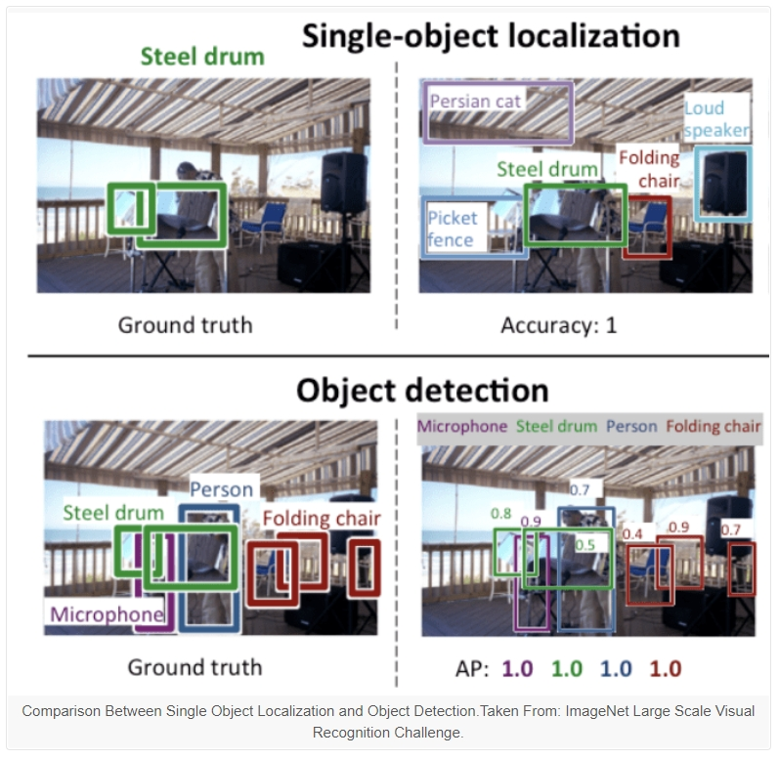

Slide 10
let’s take a look at some recent top-performing deep learning models.

Slide 11
R-CNN Model Family
The R-CNN family of methods refers to the R-CNN, which may stand for “Regions with CNN Features” or “Region-Based Convolutional Neural Network,” developed by Ross Girshick, et al. in 2014.
This includes the techniques R-CNN, Fast R-CNN, and Faster-RCNN designed and demonstrated for object localization and object recognition.

Slide 12
R-CNN
The R-CNN was described in the 2014 paper by Ross Girshick, et al. from UC Berkeley titled “Rich feature hierarchies for accurate object detection and semantic segmentation.”
It may have been one of the first large and successful application of convolutional neural networks to the problem of object localization, detection, and segmentation. The approach was demonstrated on benchmark datasets, achieving then state-of-the-art results on the VOC-2012 dataset and the 200-class ILSVRC-2013 object detection dataset.

Slide 13
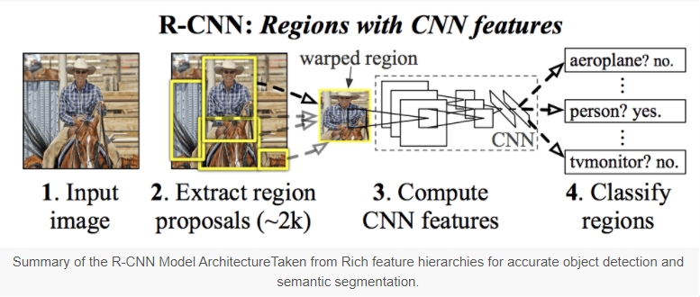
R-CNN

Slide 14
Problems with R-CNN
It still takes a huge amount of time to train the network as you would have to classify 2000 region proposals per image.
It cannot be implemented real time as it takes around 47 seconds for each test image.
The selective search algorithm is a fixed algorithm. Therefore, no learning is happening at that stage. This could lead to the generation of bad candidate region proposals.

Slide 15
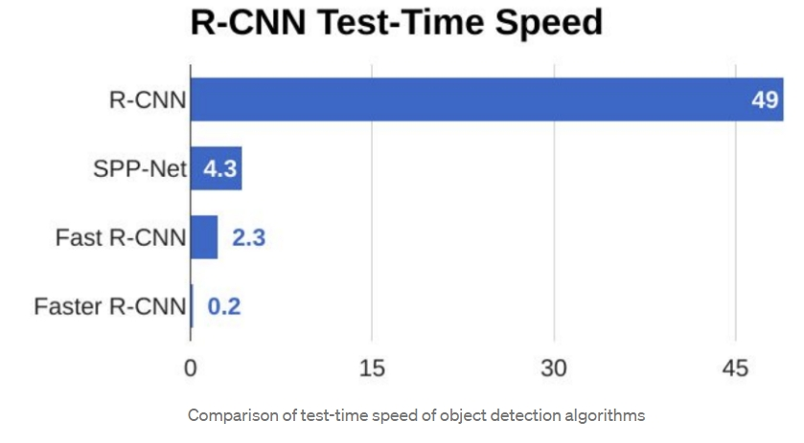

Slide 16
YOLO Model Family
Another popular family of object recognition models is referred to collectively as YOLO or “You Only Look Once,” developed by Joseph Redmon, et al.
The R-CNN models may be generally more accurate, yet the YOLO family of models are fast, much faster than R-CNN, achieving object detection in real-time.

Slide 17
YOLO
The YOLO model was first described by Joseph Redmon, et al. in the 2015 paper titled “You Only Look Once: Unified, Real-Time Object Detection.” Note that Ross Girshick, developer of R-CNN, was also an author and contributor to this work, then at Facebook AI Research.
The approach involves a single neural network trained end to end that takes a photograph as input and predicts bounding boxes and class labels for each bounding box directly. The technique offers lower predictive accuracy (e.g. more localization errors), although operates at 45 frames per second and up to 155 frames per second for a speed-optimized version of the model.

Slide 18
YOLO
Unlike systems like R-CNN and Fast R-CNN (CNN meaning Convolutional Neural Network), it’s trained to do classification and bounding box regression at the same time. This makes it a more elegant and streamlined algorithm. However, this also makes it more difficult to pick out smaller objects. YOLO is therefore much faster than most convolutional neural networks in its application, more than 1000x faster than R-CNN and 100x faster than Fast R-CNN.
Unfortunately, this does produce a trade-off between speed and accuracy. Systems using YOLO as the primary object detection algorithm require thousands of data inputs to train with in exchange for high accuracy rates.
YOLO v2,v3,v4,v5

